Slide 1
CSC D70: Compiler Optimization Memory Optimizations
Prof. Gennady Pekhimenko
University of Toronto
Winter 2023
The content of this lecture is adapted from the lectures of
Todd Mowry, Greg Steffan, and Phillip Gibbons

Slide 2
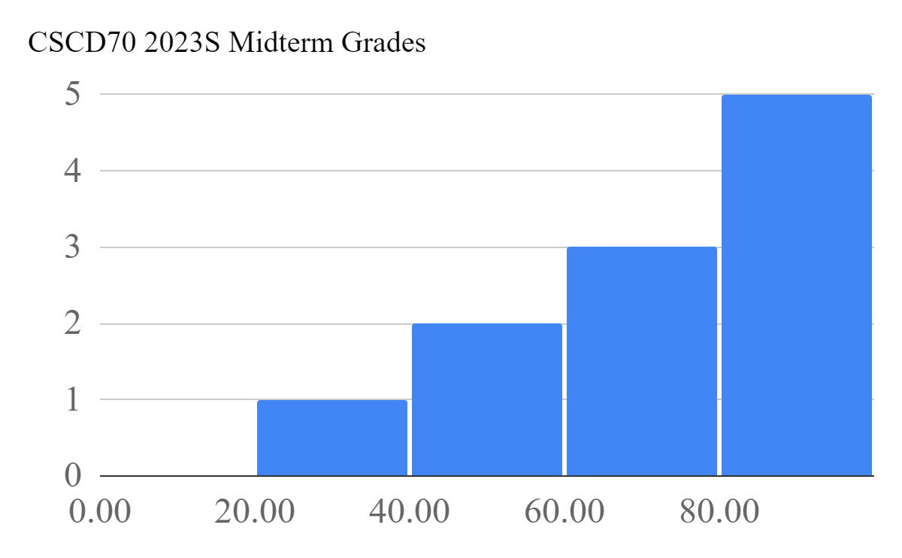
Midterm results
Average: 70

Slide 3
Pointer Analysis (Summary)
Pointers are hard to understand at compile time!
accurate analyses are large and complex
Many different options:
Representation, heap modeling, aggregate modeling, flow sensitivity, context sensitivity
Many algorithms:
Address-taken, Steensgard, Andersen
BDD-based, probabilistic
Many trade-offs:
space, time, accuracy, safety
Choose the right type of analysis given how the information will be used

Slide 4
Caches: A Quick Review
How do they work?
Why do we care about them?
What are typical configurations today?
What are some important cache parameters that will affect performance?

Slide 5
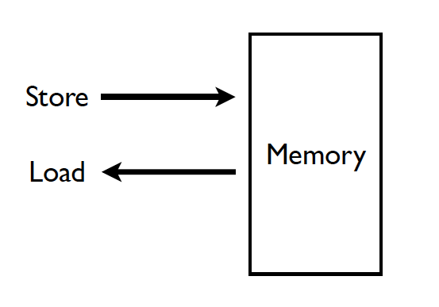
Memory (Programmer’s View)

Slide 6
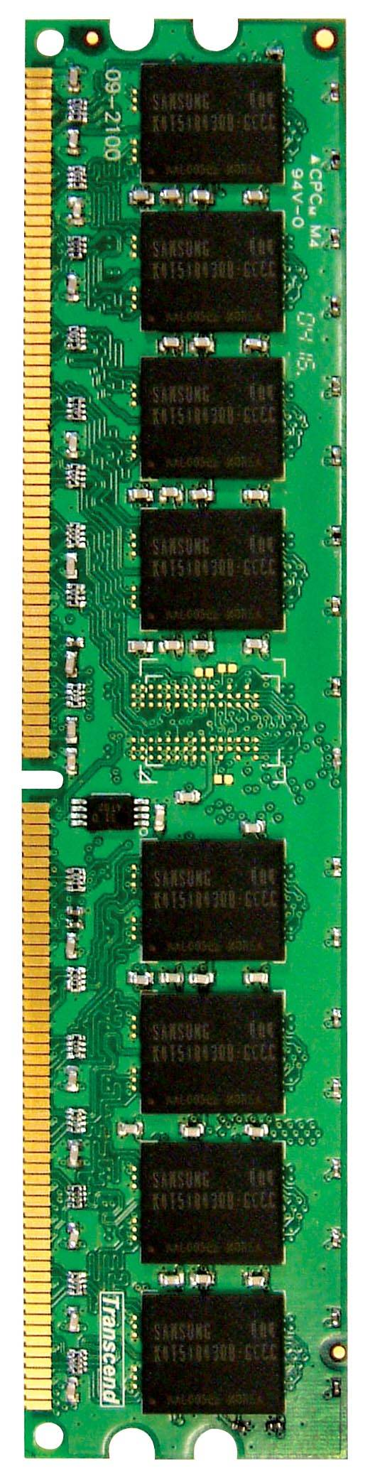
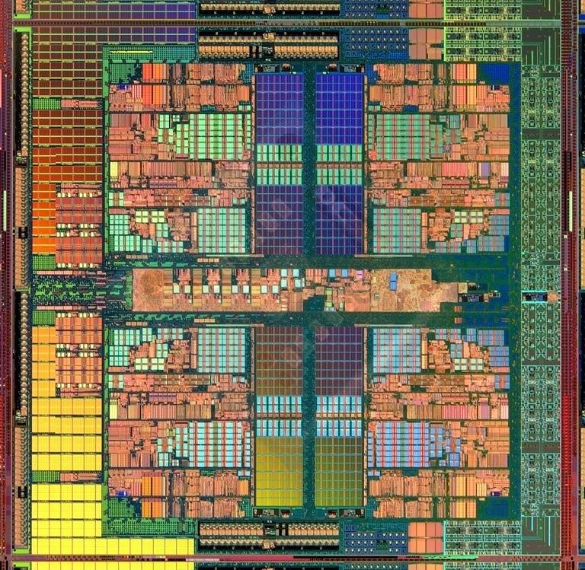
Memory in a Modern System
CORE 0
L2 CACHE 1
CORE 1
L2 CACHE 0
SHARED L3 CACHE
DRAM INTERFACE
DRAM MEMORY CONTROLLER
DRAM BANKS
L2 CACHE 2
CORE 3
CORE 2
L2 CACHE 3

Slide 7
Ideal Memory
Zero access time (latency)
Infinite capacity
Zero cost
Infinite bandwidth (to support multiple accesses in parallel)

Slide 8
The Problem
Ideal memory’s requirements oppose each other
Bigger is slower
Bigger → Takes longer to determine the location
Faster is more expensive
Memory technology: SRAM vs. DRAM vs. Flash vs. Disk vs. Tape
Higher bandwidth is more expensive
Need more banks, more ports, higher frequency, or faster technology

Slide 9
Memory Technology: DRAM
Dynamic random access memory
Capacitor charge state indicates stored value
Whether the capacitor is charged or discharged indicates storage of 1 or 0
1 capacitor
1 access transistor
Capacitor leaks through the RC path
DRAM cell loses charge over time
DRAM cell needs to be refreshed
row enable
_bitline

Slide 10
Memory Technology: SRAM
Static random access memory
Two cross coupled inverters store a single bit
Feedback path enables the stored value to persist in the “cell”
4 transistors for storage
2 transistors for access
row select
bitline
_bitline

Slide 11
Why Memory Hierarchy?
We want both fast and large
But we cannot achieve both with a single level of memory
Idea: Have multiple levels of storage (progressively bigger and slower as the levels are farther from the processor) and ensure most of the data the processor needs is kept in the fast(er) level(s)

Slide 12
The Memory Hierarchy
move what you use here
fast
small
With good locality of reference, memory appears as fast as
and as large as
faster per byte
cheaper per byte
backup
everything
here
big but slow

Slide 13
Memory Hierarchy
Fundamental tradeoff
Fast memory: small
Large memory: slow
Idea: Memory hierarchy
Latency, cost, size,
bandwidth
Hard Disk
Main
Memory
(DRAM)
CPU
Cache
RF

Slide 14
Caching Basics: Exploit Temporal Locality
Idea: Store recently accessed data in automatically managed fast memory (called cache)
Anticipation: the data will be accessed again soon
Temporal locality principle
Recently accessed data will be again accessed in the near future
This is what Maurice Wilkes had in mind:
Wilkes, “Slave Memories and Dynamic Storage Allocation,” IEEE Trans. On Electronic Computers, 1965.
“The use is discussed of a fast core memory of, say 32000 words as a slave to a slower core memory of, say, one million words in such a way that in practical cases the effective access time is nearer that of the fast memory than that of the slow memory.”

Slide 15
Caching Basics: Exploit Spatial Locality
Idea: Store addresses adjacent to the recently accessed one in automatically managed fast memory
Logically divide memory into equal size blocks
Fetch to cache the accessed block in its entirety
Anticipation: nearby data will be accessed soon
Spatial locality principle
Nearby data in memory will be accessed in the near future
E.g., sequential instruction access, array traversal
This is what IBM 360/85 implemented
16 Kbyte cache with 64 byte blocks
Liptay, “Structural aspects of the System/360 Model 85 II: the cache,” IBM Systems Journal, 1968.

Slide 16
Optimizing Cache Performance
Things to enhance:
temporal locality
spatial locality
Things to minimize:
conflicts (i.e. bad replacement decisions)
What can the compiler do to help?

Slide 17
Two Things We Can Manipulate
Time:
When is an object accessed?
Space:
Where does an object exist in the address space?
How do we exploit these two levers?

Slide 18
Time: Reordering Computation
What makes it difficult to know when an object is accessed?
How can we predict a better time to access it?
What information is needed?
How do we know that this would be safe?

Slide 19
Space: Changing Data Layout
What do we know about an object’s location?
scalars, structures, pointer-based data structures, arrays, code, etc.
How can we tell what a better layout would be?
how many can we create?
To what extent can we safely alter the layout?

Slide 20
Types of Objects to Consider
Scalars
Structures & Pointers
Arrays

Slide 21
Scalars
Locals
Globals
Procedure arguments
Is cache performance a concern here?
If so, what can be done?
int x;
double y;
foo(int a){
int i;
…
x = a*i;
…
}

Slide 22
Structures and Pointers
struct {
int count;
double velocity;
double inertia;
struct node *neighbors[N];
} node;
What can we do here?
within a node
across nodes
What limits the compiler’s ability to optimize here?

Slide 23
Arrays
double A[N][N], B[N][N];
…
for i = 0 to N-1
for j = 0 to N-1
A[i][j] = B[j][i];
usually accessed within loops nests
makes it easy to understand “time”
what we know about array element addresses:
start of array?
relative position within array

Slide 24
Handy Representation: “Iteration Space”
i
for i = 0 to N-1
for j = 0 to N-1
A[i][j] = B[j][i];
j
each position represents an iteration

Slide 25
Visitation Order in Iteration Space
i
for i = 0 to N-1
for j = 0 to N-1
A[i][j] = B[j][i];
j
Note: iteration space ≠ data space

Slide 26
When Do Cache Misses Occur?
for i = 0 to N-1
for j = 0 to N-1
A[i][j] = B[j][i];
A
B
i
i
j
j

Slide 27
When Do Cache Misses Occur?
i
for i = 0 to N-1
for j = 0 to N-1
A[i+j][0] = i*j;
j

Slide 28
Optimizing the Cache Behavior of Array Accesses
We need to answer the following questions:
when do cache misses occur?
use “locality analysis”
can we change the order of the iterations (or possibly data layout) to produce better behavior?
evaluate the cost of various alternatives
does the new ordering/layout still produce correct results?
use “dependence analysis”

Slide 29
Examples of Loop Transformations
Loop Interchange
Cache Blocking
Skewing
Loop Reversal
…

Slide 30
Loop Interchange
for i = 0 to N-1
for j = 0 to N-1
A[j][i] = i*j;
for j = 0 to N-1
for i = 0 to N-1
A[j][i] = i*j;
i
j
Hit
Miss
j
i
(assuming N is large relative to cache size)

Slide 31
Cache Blocking (aka “Tiling”)
for JJ = 0 to N-1 by B
for i = 0 to N-1
for j = JJ to min(N-1,JJ+B-1)
f(A[i],A[j]);
for i = 0 to N-1
for j = 0 to N-1
f(A[i],A[j]);
A[i]
A[j]
A[i]
A[j]
i
i
i
i
j
j
j
j
now we can exploit temporal locality

Slide 32
Impact on Visitation Order in Iteration Space
for JJ = 0 to N-1 by B
for i = 0 to N-1
for j = JJ to min(N-1,JJ+B-1)
f(A[i],A[j]);
for i = 0 to N-1
for j = 0 to N-1
f(A[i],A[j]);
i
i
j
j

Slide 33
Cache Blocking in Two Dimensions
for JJ = 0 to N-1 by B
for KK = 0 to N-1 by B
for i = 0 to N-1
for j = JJ to min(N-1,JJ+B-1)
for k = KK to min(N-1,KK+B-1)
c[i,k] += a[i,j]*b[j,k];
for i = 0 to N-1
for j = 0 to N-1
for k = 0 to N-1
c[i,k] += a[i,j]*b[j,k];
brings square sub-blocks of matrix “b” into the cache
completely uses them up before moving on

Slide 34
Predicting Cache Behavior through “Locality Analysis”
Definitions:
Reuse:
accessing a location that has been accessed in the past
Locality:
accessing a location that is now found in the cache
Key Insights
Locality only occurs when there is reuse!
BUT, reuse does not necessarily result in locality.
why not?

Slide 35
Steps in Locality Analysis
1. Find data reuse
if caches were infinitely large, we would be finished
2. Determine “localized iteration space”
set of inner loops where the data accessed by an iteration is expected to fit within the cache
3. Find data locality:
reuse ∩ localized iteration space ⇒ locality

Slide 36
Types of Data Reuse/Locality
for i = 0 to 2
for j = 0 to 100
A[i][j] = B[j][0] + B[j+1][0];
Hit
Miss
A[i][j]
B[j+1][0]
B[j][0]
i
i
i
j
j
j
Spatial
Temporal
Group

Slide 37
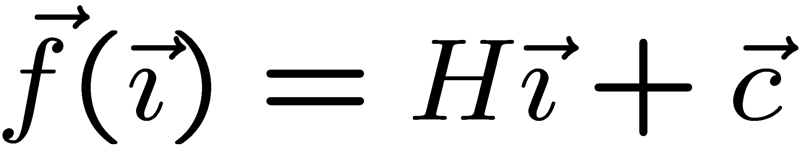
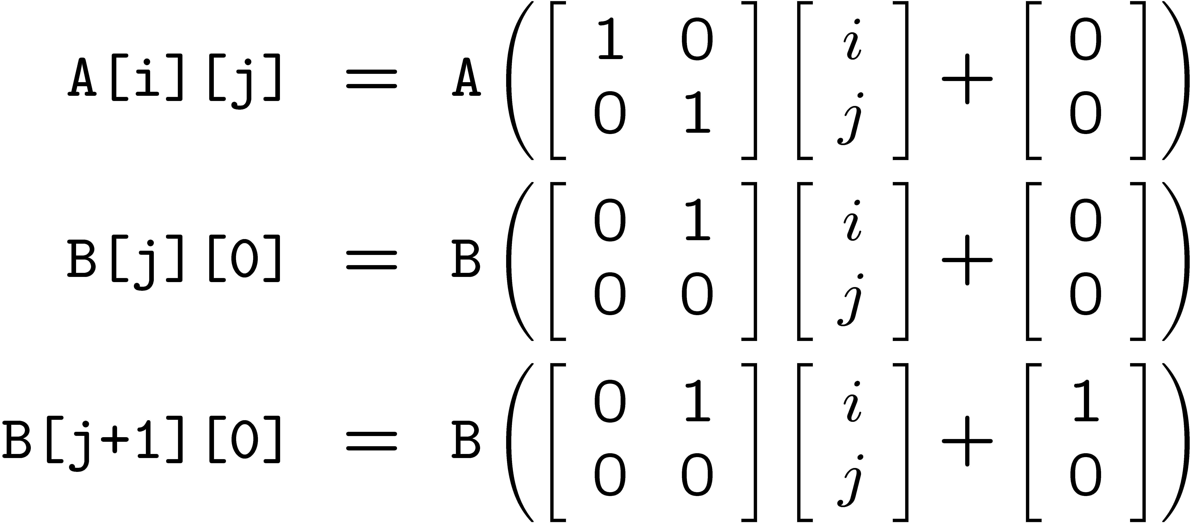
Reuse Analysis: Representation
for i = 0 to 2
for j = 0 to 100
A[i][j] = B[j][0] + B[j+1][0];
Map n loop indices into d array indices via array indexing function:

Slide 38
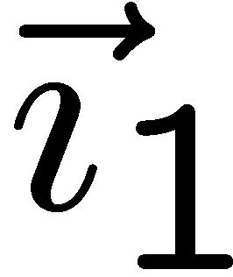
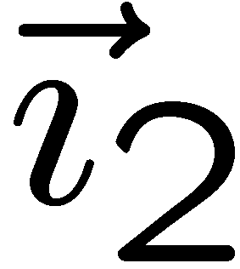
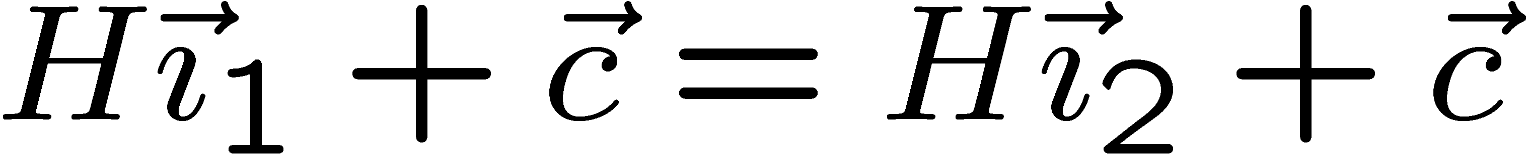
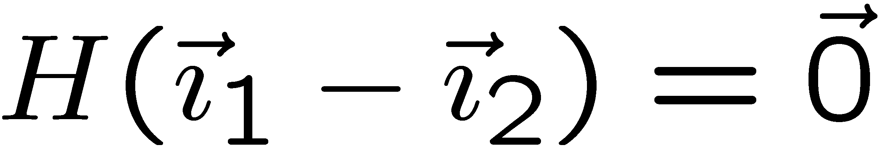

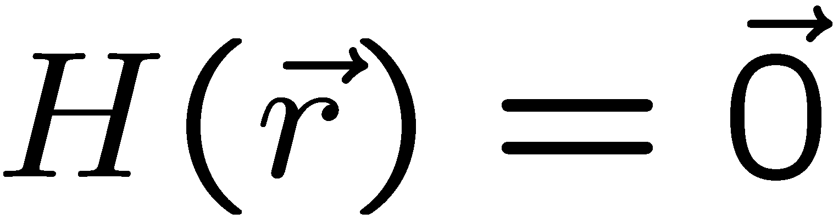
Finding Temporal Reuse
Temporal reuse occurs between iterations and whenever:
Rather than worrying about individual values of and, we say that reuse occurs along direction vector when:
Solution: compute the nullspace of H

Slide 39
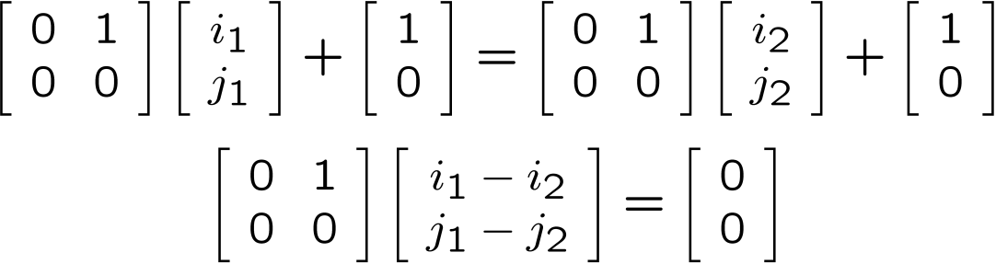
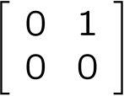
Temporal Reuse Example
for i = 0 to 2
for j = 0 to 100
A[i][j] = B[j][0] + B[j+1][0];
Reuse between iterations (i₁,j₁) and (i₂,j₂) whenever:
True whenever j₁ = j₂, and regardless of the difference between i₁ and i₂.
i.e. whenever the difference lies along the nullspace of ,
which is span{(1,0)} (i.e. the outer loop).

Slide 40
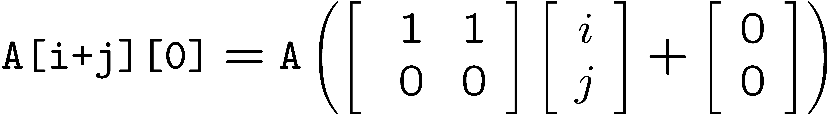
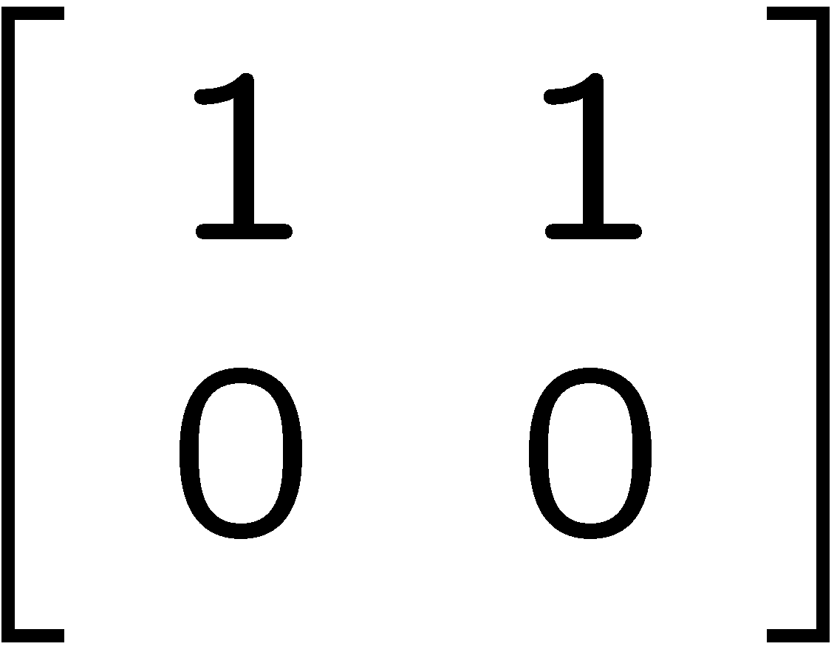
More Complicated Example
for i = 0 to N-1
for j = 0 to N-1
A[i+j][0] = i*j;
i
Hit
Miss
j
Nullspace of = span{(1,-1)}.

Slide 41
Computing Spatial Reuse
Replace last row of H with zeros, creating H_{s}
Find the nullspace of H_{s}
Result: vector along which we access the same row

Slide 42
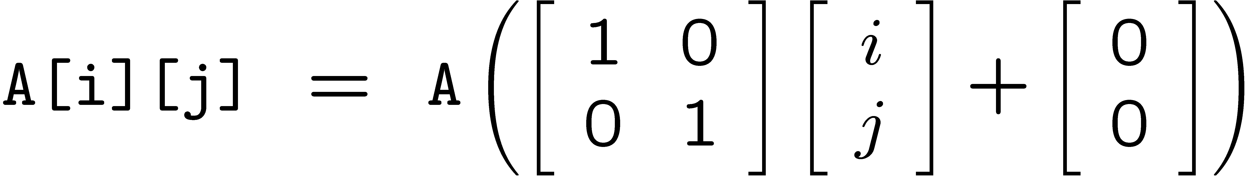
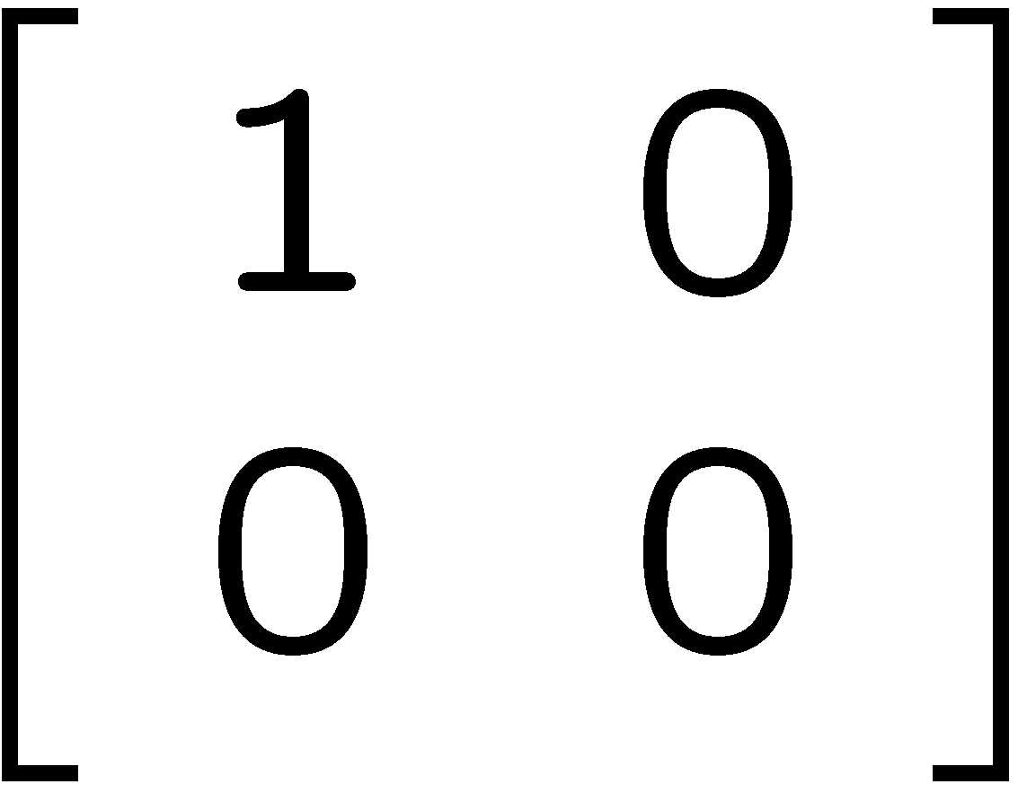
Computing Spatial Reuse: Example
i
for i = 0 to 2
for j = 0 to 100
A[i][j] = B[j][0] + B[j+1][0];
Hit
Miss
j
H_{s} =
Nullspace of H_{s} = span{(0,1)}
i.e. access same row of A[i][j] along inner loop

Slide 43
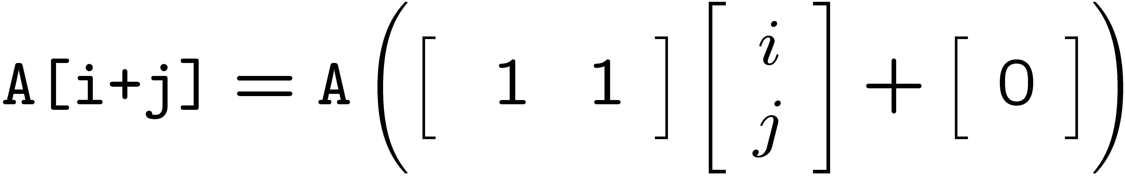
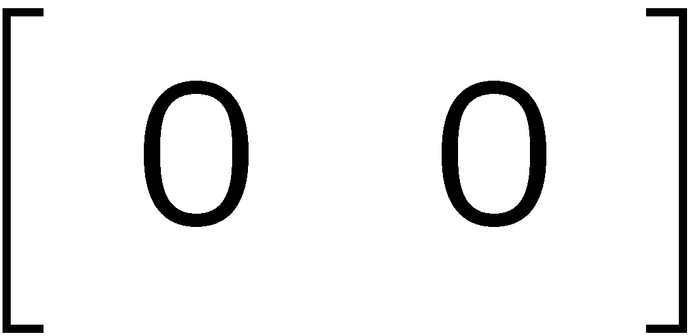
Computing Spatial Reuse: More Complicated Example
for i = 0 to N-1
for j = 0 to N-1
A[i+j] = i*j;
i
Hit
Miss
H_{s} =
Nullspace of H = span{(1,-1)}
Nullspace of H_{s} = span{(1,0),(0,1)}
j

Slide 44
Group Reuse
for i = 0 to 2
for j = 0 to 100
A[i][j] = B[j][0] + B[j+1][0];
Only consider “uniformly generated sets”
index expressions differ only by constant terms
Check whether they actually do access the same cache line
Only the “leading reference” suffers the bulk of the cache misses

Slide 45
Localized Iteration Space
Given finite cache, when does reuse result in locality?
Localized if accesses less data than effective cache size
for i = 0 to 2
for j = 0 to 8
A[i][j] = B[j][0] + B[j+1][0];
for i = 0 to 2
for j = 0 to 1000000
A[i][j] = B[j][0] + B[j+1][0];
i
i
B[j+1][0]
B[j+1][0]
j
j
Localized: both i and j loops
(i.e. span{(1,0),(0,1)})
Localized: j loop only
(i.e. span{(0,1)})

Slide 46
Computing Locality
Reuse Vector Space ∩ Localized Vector Space ⇒ Locality Vector Space
Example:
If both loops are localized:
span{(1,0)} ∩ span{(1,0),(0,1)} ⇒ span{(1,0)}
i.e. temporal reuse does result in temporal locality
If only the innermost loop is localized:
span{(1,0)} ∩ span{(0,1)} ⇒ span{}
i.e. no temporal locality
for i = 0 to 2
for j = 0 to 100
A[i][j] = B[j][0] + B[j+1][0];

Slide 47
CSC D70: Compiler Optimization Memory Optimizations
Prof. Gennady Pekhimenko
University of Toronto
Winter 2023
The content of this lecture is adapted from the lectures of
Todd Mowry and Phillip Gibbons

